Slide 1
Wednesday Bellringer
What are Blaschke certificates?
List 2 of our classroom procedures
Directions: clearly label your page with your name and the date, and use a new sheet of paper each week

Slide 2
Lesson 1A:
Why Study Chemistry?
Science

Slide 3
Why Study Science?
The purpose of science
Science does not establish truth.
Science makes models (simplified representations).

Slide 4
Why Study Science?
The purpose of science, cont.
The goal of science is “workability.”
Science always has uncertainty.
Faith is required.

Slide 5
Why Study Science?
Naturalistic worldview
Matter is all that exists.
Human reason informed by science is the only reliable path to truth.
Evolution − the Creator = no accountability.

Slide 6
Why Study Science?
Christian worldview
We are loved and saved by God
Thus, the Bible is our ultimate authority.
We choose to see the world through the lens of the Bible

Slide 7
Genesis 1:26-28
⁶ Then God said, “Let us make man in our image, after our likeness. And let them have dominion over the fish of the sea and over the birds of the heavens and over the livestock and over all the earth and over every creeping thing that creeps on the earth.”
²⁷ So God created man in his own image, in the image of God he created him; male and female he created them.
²⁸ And God blessed them. And God said to them, “Be fruitful and multiply and fill the earth and subdue it, and have dominion over the fish of the sea and over the birds of the heavens and over every living thing that moves on the earth.”

Slide 8
Creation Mandate
Man is to exercise good and wise dominion as God’s representative.

Slide 9
Creation Mandate:
To steward something we must know it
Redemption:
Place every aspect of life under God and the gospel

Slide 10
Why Study Science?
Why study science?
To fulfill the Creation Mandate
To know God
To redeem the world
Chemistry?

Slide 11
Why Study Chemistry?
Why study chemistry?
To understand the details of Creation
Foundation for all sciences
Practical applications
Note: Naturalistic and Christian worldviews don’t differ much about Chemistry

Slide 12
Why Study Chemistry?
Some practical applications:
Logical thinking
Problem solving skills
College prep
Opens career options
Cooking
Solves “mysteries”
(ex: why does water boil?)

Slide 13
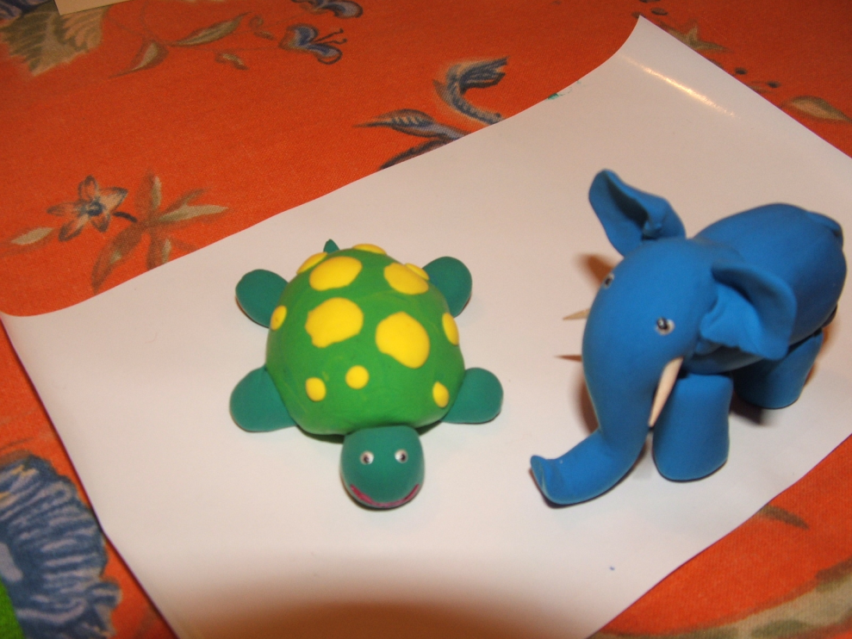
Modeling

Slide 14
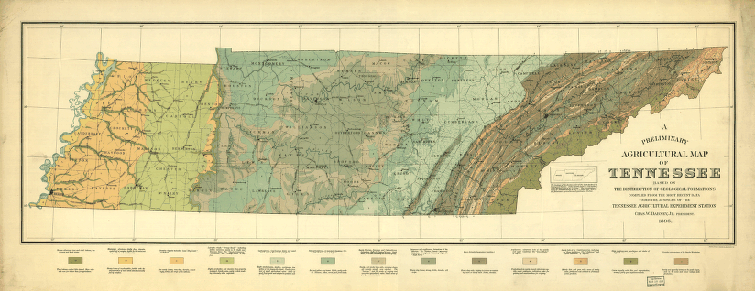
Scientific Models
Scientific models: a simplified representation of phenomena
Ex: a map

Slide 15
What Is Chemistry?

Slide 16
Thursday Bellringer (8/16)
What do scientists who are Christians call Genesis 1:26-28?
What does Genesis 1:26-28 command us to do?

Slide 17
Chemistry
the study of matter
structure and composition
changes in structure and composition
interactions with energy
properties
takes up space and has mass

Slide 18
Influences on Chemistry
Old Testament Times— The Age of Practical Skill
Focused on practicality
Metallurgy— the process of extracting metal from ore

Slide 19
Influences on Chemistry
Old Testament Times— The Age of Practical Skill
Apothecaries— pharmacists

Slide 20
Influences on Chemistry
Ancient Greece— The Age of Critical Thought
Focused on philosophy and knowledge
Developed critical thinking, but no experimentation

Slide 21
Influences on Chemistry
Ancient Greece— The Age of Critical Thought
Stagnated science for centuries
Four elements—earth, wind, fire, water

Slide 22
Influences on Chemistry
The Alchemists—The Age of Applied Experimentation
Focused on experimentation
Developed sublimation, precipitation, distillation, and crystallization

Slide 23
Influences on Chemistry
The Alchemists—The Age of Applied Experimentation
“transmutation”— tried to change elements (lead into gold)
Paracelsus—started pharmacology

Slide 24
Influences on Chemistry
The Transition— The Rise of Modern Chemistry
Questioned Greek “truths” following the Reformation
Boyle—shattered tradition by proposing a new definition of elements

Slide 25
Influences on Chemistry
The Transition— The Rise of Modern Chemistry
Priestley—discovered oxygen by experimentation

Slide 26
Influences on Chemistry
The Transition— The Rise of Modern Chemistry
Lavoisier—
engaged in careful experimenting and recording
overthrew the phlogiston theory

Slide 27
Chemistry
An academic field since the 1800’s
Different branches developed

Slide 28
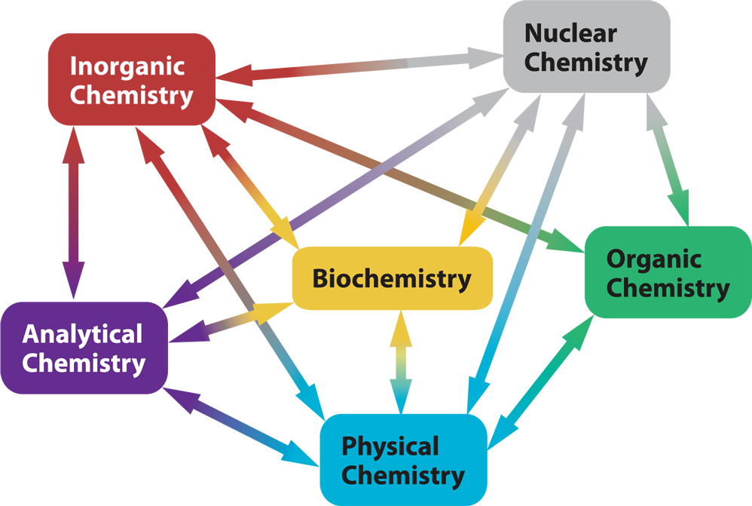
Notes:
Chemistry textbook p. 11

Slide 29
Branches of Chemistry
Inorganic—all elements but carbon
Organic—carbon compounds
Biochemistry—chemical processes in living things

Slide 30
Branches of Chemistry
Nuclear—nucleus and radioactivity
Physical—interactions and energy changes
Analytical—
Qualitative: What is it?
Quantitative: How much?

Slide 31
Physical
Chemistry
Chemistry
Physics
Biochemistry
Biophysics
Biology
Notes:
Chemistry textbook p. 12

Slide 32
What Do Chemists Do?

Slide 33
science
the total collection of knowledge gained through the systematic observation of nature

Slide 34
Science
Pure Science— probes world simply to learn new things
Applied Science— searches for specific applications
Scientific Questions— direct and stimulate scientific inquiry

Slide 35
How Do Chemists DO Science?

Slide 36
Scientists …
Notice something which elicits a question
Gather information
Objective information
Unaffected by observer’s personal inclinations and presuppositions

Slide 37
Scientists …
Notice something which elicits a question
Gather information
Objective information
Subjective information
Affected by observer’s personal inclinations and presuppositions

Slide 38
Scientists …
Collect data
Quantitative—numerical
Qualitative—nonnumerical
Use reasoning processes
Deductive reasoning
Applying a premise to many different situations

Slide 39
Scientists …
Collect data
Quantitative—numerical
Qualitative—nonnumerical
Use reasoning processes
Deductive reasoning
Inductive reasoning
Using facts to lead into a conclusion

Slide 40
Scientists …
Make models
To make sense of data
To identify causes and effects
To suggest practical application
To establish connections
To direct predictions

Slide 41
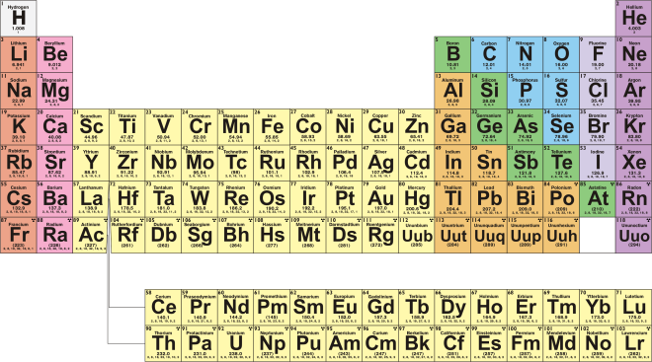
Models are simpler
than reality for the sake of
workability.
Workability is the key
to models.
Notes:
Periodic Table - Chemistry textbook pp. 108-9

Slide 42
Scientists …
Perform experiments

Slide 43
experiment
a repeatable method that involves observing a natural process, sometimes under controlled conditions, for the purpose of analysis

Slide 44
Scientists …
Perform experiments
Controlled—only one condition is varied at a time
Record data from experimentation
Empirical data—gathered experimentally

Slide 45
Scientists …
Form hypotheses

Slide 46
hypothesis
a simple, reasonable, testable statement that tries to predict the results of an experiment

Slide 47
Scientists …
Form hypotheses
Perform natural experiments

Slide 48
natural experiment
an experiment in which the conditions cannot be controlled

Slide 49
Scientists …
Form hypotheses
Perform natural experiments
Perform scientific surveys—randomly selecting representative samples

Slide 50
Scientists …
Formulate results
Classify
Simplify
Enter in charts and graphs
Communicate findings
Peer-reviewed scientific journals
Internet forums

Slide 51
Scientists …
Formulate theories
Must consistently explain a phenomenon
Can be thought of as scientific models
Can be modified
Must be supported by evidence
Are not “provably” true
Notes:
Science does not find “TRUTH”

Slide 52
Scientists …
Frame scientific laws

Slide 53
law
statement of a recognizable, repeating pattern in the universe

Slide 54
Scientists …
Frame scientific laws
Use the Scientific Method

Slide 55
scientific method
an inductive approach to discover information about the universe

Slide 56
Scientists …
Frame scientific laws
Use the Scientific Method
Many versions
No standardized form

Slide 57
Recognize a problem.
Make a hypothesis.
Make observations to test the hypothesis.
Verify the hypothesis.
Organize and analyze data.
Notes:
Chemistry textbook p. 17

